Slide 1
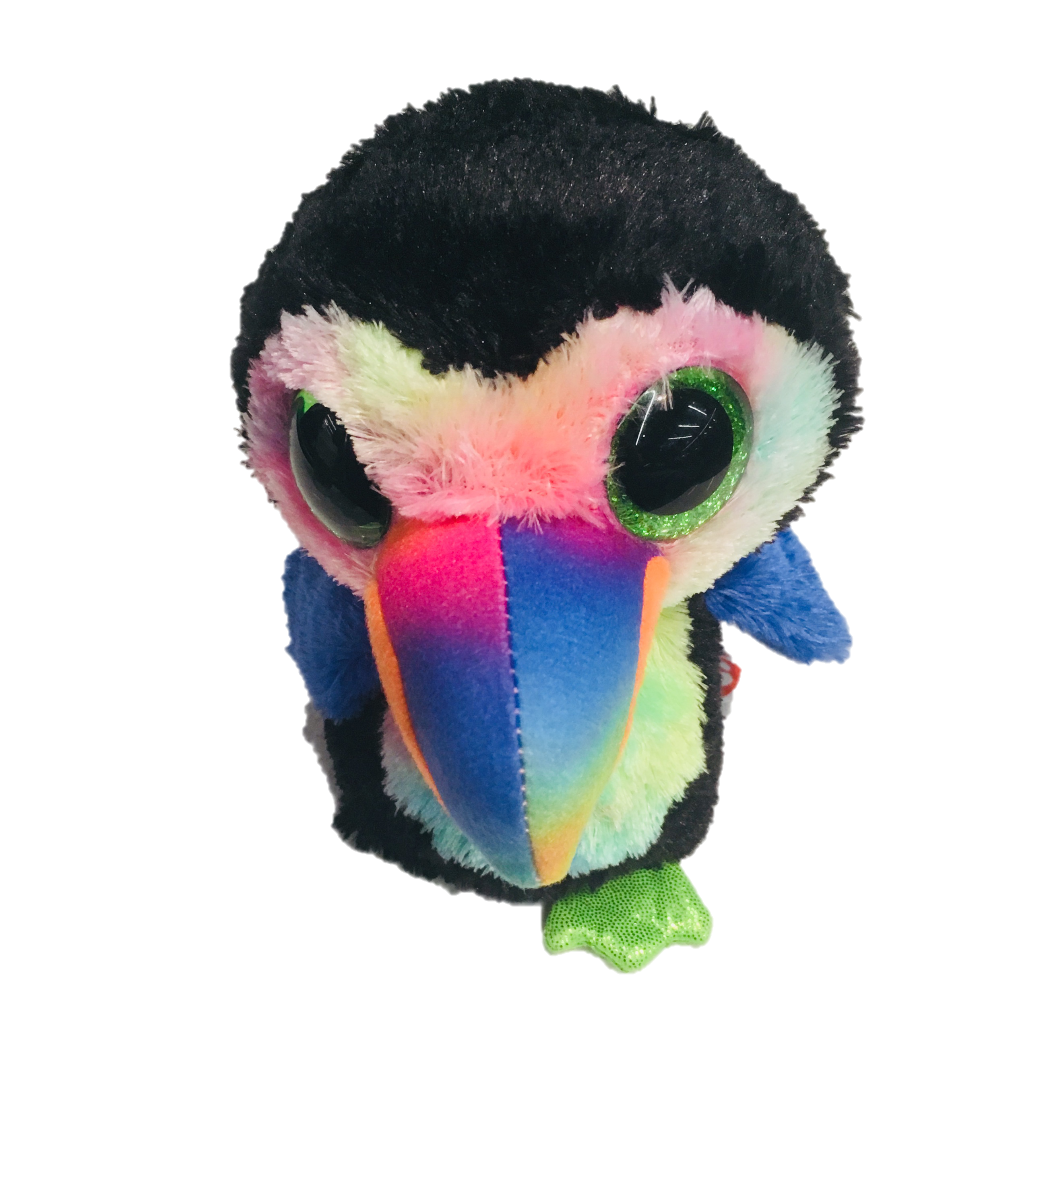
oTree workshop
Philipp Chapkovski
European University Institute
University of Hamburg
May 29-30, 2018
Day 1

Slide 2
oTree
platform to run interactive online experiments
written on Python
open source
based on Django framework
responsive – can be run in mobile browsers, tablets etc.
Materials and code for this workshop: | http://bit.ly/otree_teaching
My e-mail: | chapkovski@gmail.com
oTree support group: | https://groups.google.com/forum/#!forum/otree
oTree documentation: | http://otree.readthedocs.org/
general coding help: | https://stackoverflow.com

Slide 3
oTree
link to follow:
http://bit.ly/otree2018

Slide 4
Outline
Guess random number game
Ultimatum game
Public good game

Slide 5
What kind of ‘basic’ behavioral games are widely used?

Slide 6
What kind of ‘basic’ behavioral games are widely used?
Dictator Game
Trust (Investment) game
Prisoner’s Dilemma
Public good game (PGG)
PGG with punishment (Fehr and Gächter)
Beauty contest (Guess 2/3)
Real effort tasks
Principal-agent dilemma

Slide 7


Our main goal:
Show something to the participant.
Get his/her reaction on it

Slide 8
Models
Pages
Templates

Slide 9
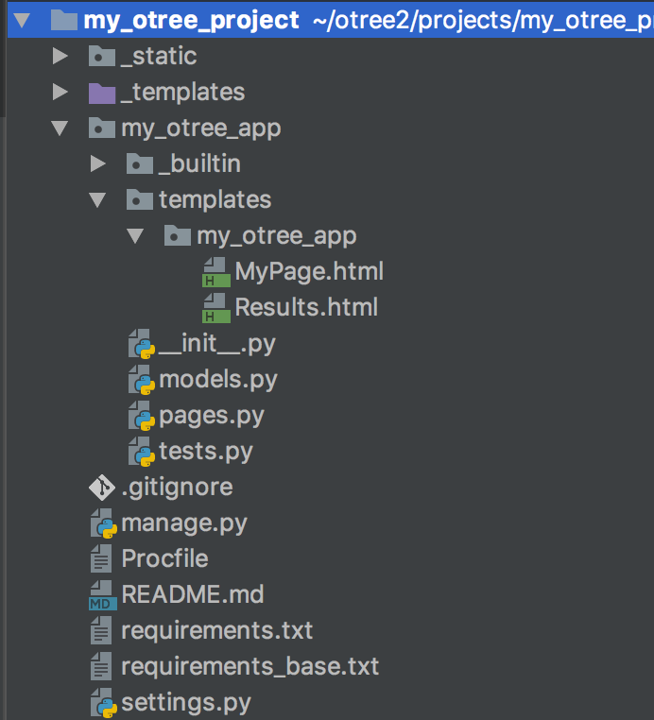

Slide 10
Models are responsible for storing and processing data in the database
Anything that you need to be stored should be defined as a field in models.py file
Models
Pages
Templates

Slide 11
Pages are responsible for retrieving and passing back data from models to templates and vice versa.
If you need to show something to a participant or to get his/her input, you need to state in pages.py
Models
Pages
Templates

Slide 12
Templates are just ordinary html files which get the info from pages and show it to a participant.
As soon as a participant clicks ‘Next’ the data he enters is passed back to pages
Models
Pages
Templates

Slide 13

This is session.
The entire set of all participants in your lab
or online

Slide 14
This is participant.
The entire set of all participants in your lab
or online

Slide 15
Subsession
is a set of all players in one round

Slide 16
Player is an element of
subsession

Slide 17
One participant
contains the info
about all players
who he/she
‘owns’

Slide 18
The group
is a set of players
in one particular
subsession

Slide 19
One session can contain several apps

Slide 20
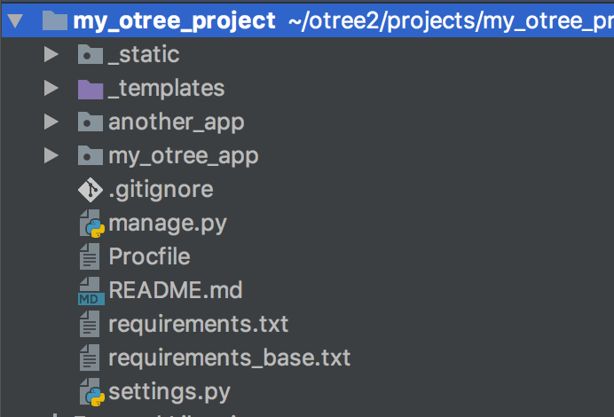
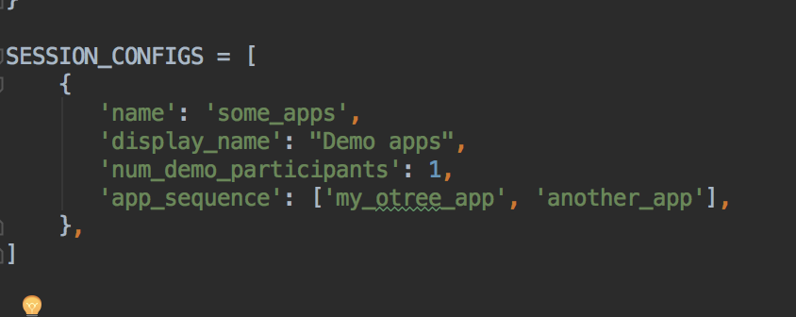
One session can contain several apps
in settings.py:

Slide 21
virtualenv
Mac/Linux | Windows
Installing
python3 -m pip install --user virtualenv | py -m pip install --user virtualenv
Creating
python3 -m virtualenv env | py -m virtualenv env
Activating
source env/bin/activate | .\env\Scripts\activate
Leaving the virtual environment
deactivate

Slide 22
Let’s create our first oTree app
Create and/or activate virtualenv
install oTree: pip install –U otree
Check version: otree --version
otree startproject my_first_project
cd my_first_project
otree startapp my_first_app
add app to settings.py
otree devserver
go to: http://127.0.0.1:8000

Slide 23

Very brief introduction

Slide 24
Structure of oTree app
Pages
Page classes
page_sequence
Models
Constants
Player, Group, Subsession
App definition in settings.py
Displaying logic
Data processing

Slide 25
Data processing: first intro
Models: where the data is stored (Player, Group, Subsession models)
Field types
doc, verbose_name, max, min, choices and other field properties

Slide 26
Anatomy of an oTree Page
Page creation:
class definition
template
When/if/for whom it is shown:
position in page_sequence
is_displayed method
What is shown:
vars_for_template method
What to do next:
before_next_page method

Slide 27
Anatomy of an oTree Page
class MyPage(Page):
form_model = ‘player’
form_fields = [‘my_field’]
page_sequence = [MyPage]

Slide 28
Field form(s) on a template
{% fieldform player.my_field label= ‘Enter something’ %}
OR:
{% for field in form %}
{% formfield field %}
{% endfor %}
OR:
{{ form }}

Slide 29
Dynamic set of forms
in Page class:
class MyPage(Page):
def get_form_fields(self):
if self.player.treatment == ‘A’:
return [‘a’, ‘b’]
else:
return [‘c’, ‘d’]

Slide 30
Dynamic min/max
you have a field donation; different endowments
in Page class:
class MyPage(Page):
def donation_max(self):
return self.player.endowment

Slide 31
Methods of an oTree Page
BEFORE page is shown:
is_displayed (should return True if page is to be shown)
vars_for_template (should return variables in a form of dictionary)
AFTER page is shown:
before_next_page

Slide 32
Typical blueprint of a game
How many players?
Do they interact in the real time?
How many rounds?
Do players have different roles?
What are the main stages within each round?
When and how payoffs are calculated?
What kind of information a player needs from other players?
What kind of external (preexisting) information is needed?
How treatments change the game flow?

Slide 33
Our workflow
Compile the blueprint
Write the code
Test it locally
Push to git repo
Push it to heroku
Share it with me (chapkovski@gmail.com)

Slide 34
Guess game: description
A player has an endowment.
Random number is generated within certain limits
A player has to guess. The closer is the guess to a real number the larger is the profit.
Two fields: what is guessed, and a player’s decision
Three screens:
Intro: instructions
Decision with instructions
Results

Slide 35
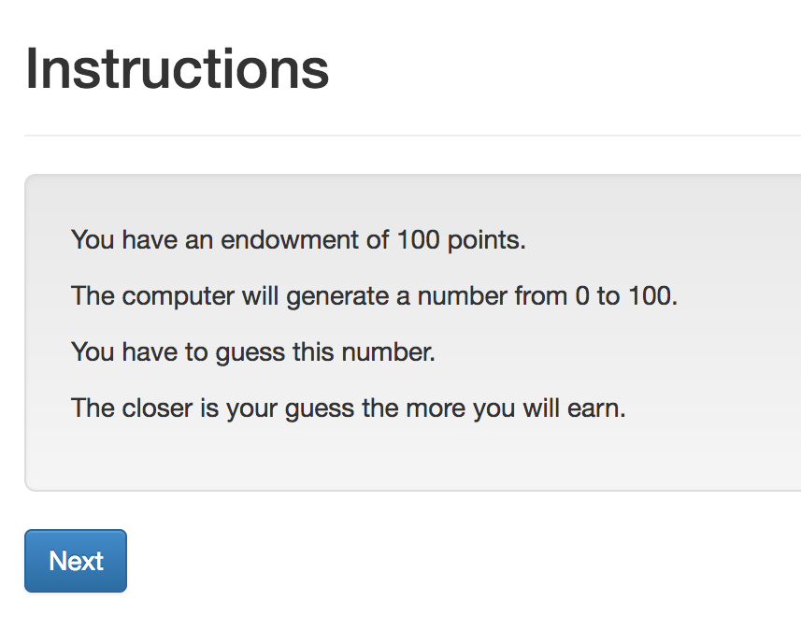
Guess game: screen 1

Slide 36
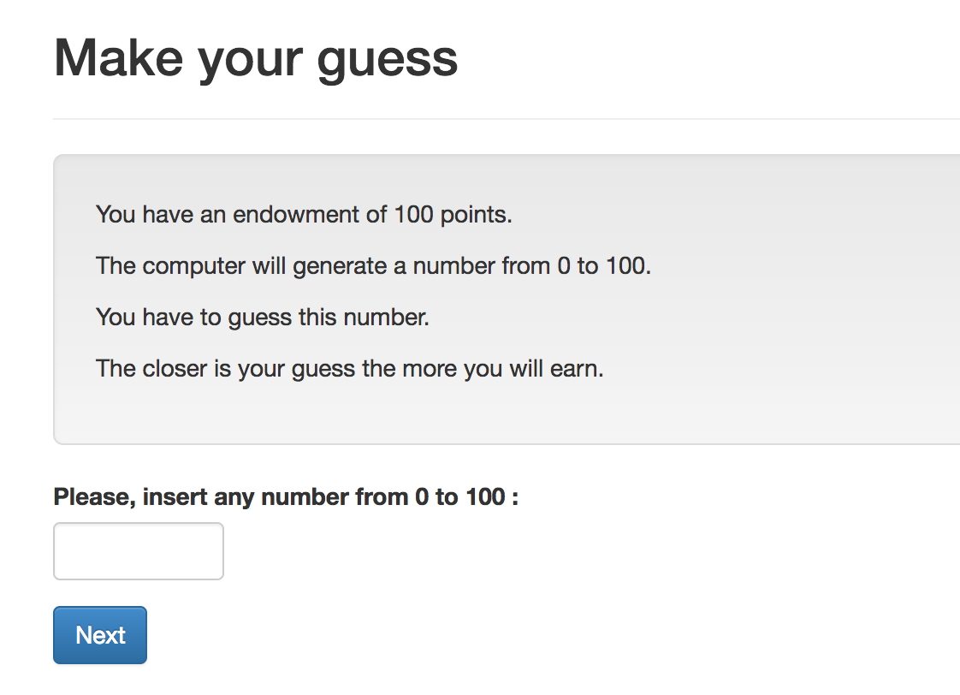
Guess game: screen 2

Slide 37
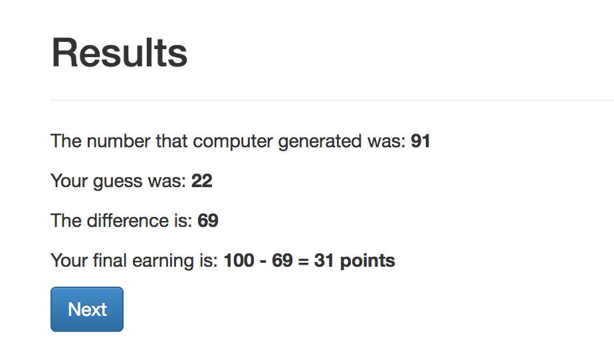
Guess game: screen 3

Slide 38
Guess game - blueprint

Slide 39
Guess game - blueprint
1 player
No interaction
1 round (or more)
No roles
Generating random number, letting player to guess, show them results
After the guess is made
No info is needed from others
Pre-generated random number
No treatments

Slide 40
Models
Constants: game parameters that stay the same for all players
Subsession: parameters that stay the same for all participants in specific round
Group: data/parameters that stay the same for all members of one group in specific round
Player: data/parameters that are unique for each player in a specific round

Slide 41
Guess game - Models
Creating new fields:
Field_Name = models.IntegerField()
Options:
Field_Name = models.IntegerField(
max=…,
min=…,
verbose_name=…,)

Slide 42
Guess game: Views
Creating new page
Class NameOfThePage(Page):
pass
Page_sequence
Page_sequence = [NameOfThePage]
By default name of the template should correspond to the page name!

Slide 43
Guess game: Views. Built-in functions
Built-in functions of pages:
”Normal” page:
def is_displayed(self):
return (True/False)
def vars_for_template(self):
return {‘var’: var}
def before_next_page(self):
…

Slide 44
Guess game - Templates
{% extends "global/Page.html" %}
{% load static otree %}
{% block title %} YOUR TITLE HERE {% endblock %}
{% block content %}
YOUR CONTENT HERE
{% endblock %}

Slide 45
Templates: using variables
In a template you can access variables defined in vars_for_template of the specific page:
{{ var }}
You can also use lists and dictionaries
You can also access any variable in Constants, Player, Group…
{{ player.payoff }}

Slide 46
Guess game - Templates
to include another file (for example instructions):
{% include ‘path_to_file/name_of_file.html %}
to make ‘Next button’:
{% next_button %}

Slide 47
Guess game: Views. Intro

Slide 48
Guess game: Models. Result:
class Player(BasePlayer):
toguess = models.IntegerField(min=Constants.minguess,
max=Constants.maxguess,
doc='random number for a player to guess')
guess = models.IntegerField(min=Constants.minguess,
max=Constants.maxguess,
verbose_name="Please, insert \
any number from {} to \
{}".format(Constants.minguess,
Constants.maxguess,),
doc='guess of the player')

Slide 49
Intro: How to do it?
Models.py: Constants:
endowment
minguess
maxguess
Intro.html:
in {% block content %}:
to refer to the constant: {{ Constants.endowment }}
Case sensitive!
No calculations! It is not Python!

Slide 50
Intro: Results:
{% extends "global/Page.html" %}
{% load staticfiles otree_tags %}
{% block title %}Instructions{% endblock %}
{% block content %}
{% include 'guess/instructions.html' %}
{% next_button %}
{% endblock %}
WHY?

Slide 51
Views.Decision

Slide 52
Views.Decision. How to do it?
Referring to models. field in views.py:
class Decision(Page):
form_model = ‘player’
form_fields = ['guess']
referring to a field in a template:
{% formfield player.guess %} OR {{form}}
Generating random number:
class Intro(Page):
def before_next_page(self):
toguess = random.randint(Constants.minguess, Constants.maxguess)
self.player.toguess = toguess

Slide 53
Views.Resuts

Slide 54
Views.Resuts. How to do it?
in views.py: Decision page:
class Decision(Page):
...
def before_next_page(self):
self.player.set_payoff()
in models.py :
class Player(BasePlayer):
…
def set_payoff(self):
self.diff = abs(self.guess - self.toguess)
self.payoff = Constants.endowment - self.diff

Slide 55
Running the app
otree devserver
go to: http://127.0.0.1:8000

Slide 56
Guess game
Write the code
Push it to git
Deploy it to heroku

Slide 57
GIT: creation
Go to your project folder in terminal/cmd/bash…
git init
git add .
git commit –m ‘Commit message’
Create a git repository in www.github.com
git add remote origin LINK_TO_GIT
git push origin master --set-upstream
More info: http://rogerdudler.github.io/git-guide/

Slide 58
GIT: pushing update
Go to your project folder in terminal/cmd/bash…
git add .
git commit –m ‘Commit message’
git push

Slide 59
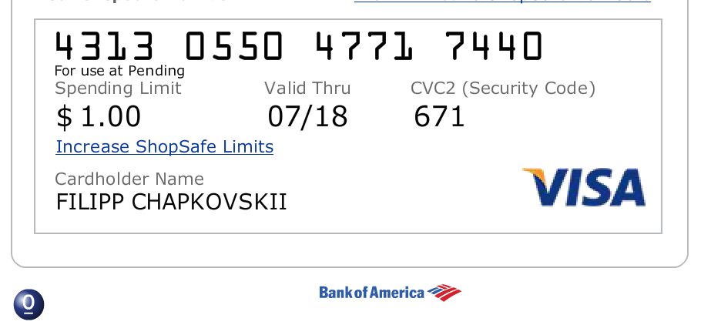
Heroku
create git first!
heroku create APP_NAME
heroku addons:create heroku-redis
git push heroku master
heroku run otree resetdb

Slide 60
Obtaining data from previous rounds
participant.get_players()
participant.payoff
player.in_all_rounds()
player.in_previous_rounds()
player.in_round(x)
player.in_rounds(x,y)
on template:
{{player.round_number}}
on page:
self.round_number

Slide 61
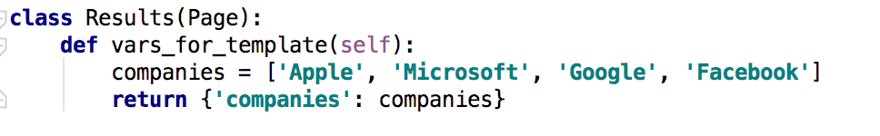
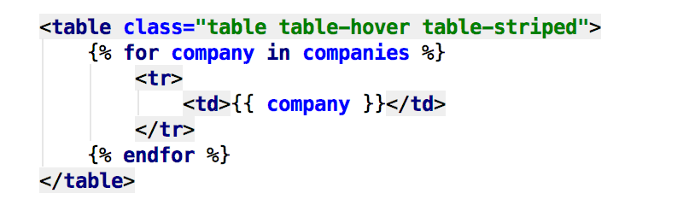
Loop through any lists
in pages
in template

Slide 62
Extra task: multi-round
make the game multi-round
Final results: an accumulated over n rounds

